Slide 1
Listening Skills

Slide 2
Game

Slide 3
Discussion

Slide 4
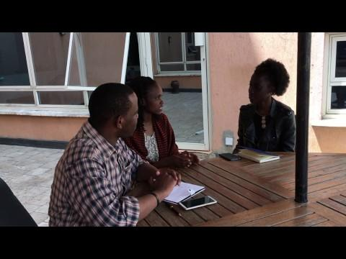
Good listening skills practices

Slide 5
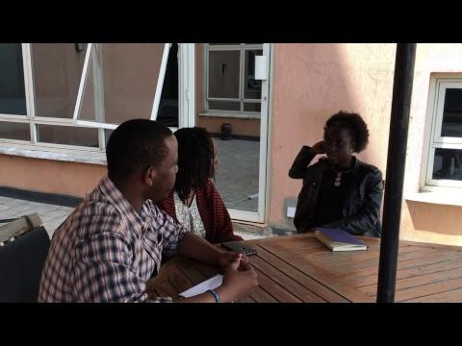
Bad listening skills practices

Slide 6
Discussion

Slide 7
Finito

